Slide 1



Dashboarding Polarized Views on Artificial Intelligence

Slide 2
Joseph David Universiti Pendidikan Sultan Idris (UPSI), Malaysia SmallJosePhD.github.io josephdavid970@gmail.com +2348169166799 +60147417961

Slide 3

CONTENTS
01
02
03
04
Learning outcomes
Web Scraping Overview
Text Mining and Sentiment Analysis Basics
Building Dashboards in R

Slide 4
LEARNING OUTCOMES
At the end of this session, participants should be able to:
Understand the concept of web scrapping;
Perform and visualize sentiment analysis on text data; and
Build dashboard with R

Slide 5
Introduction to Web Scraping
What is web scraping?
Web scraping is the automated process of extracting data from web pages.
It is a very useful tool which enable the collection of large amounts of information efficiently and convert it into a structured format like CSV, Excel, or databases.
To scrape webpages, we will need to understand a little bit about HTML (HyperText Markup Language), the language that describes web pages.

Slide 6
Introduction to Web Scraping
Legal and Ethical Considerations
The legalities of web scrapping generally depend a lot on where one reside.
However, as a general principle, if the data is public, non-personal, and factual, and the intended use of non-commercial, there’s likely to be no problem.
We also need to consider legal and ethical issues such as the term of service, copyright, and personally identifiable information.

Slide 7
Introduction to Web Scraping
Legal and Ethical Considerations
Terms of Service: Some websites have specific rules about web scraping in their terms of service (ToS). Always check these rules to ensure you’re not violating them.
Privacy: Even if the data is public, you should be extremely careful about scraping personally identifiable information like names, email addresses, phone numbers, dates of birth, etc. Anonymize or exclude sensitive information to maintain ethical standards.
Europe has strict laws about the collection or storage of such data (GDPR), and regardless of where you live you’re likely to be entering an ethical quagmire.

Slide 8
Introduction to Web Scraping
Legal and Ethical Considerations
Copyright: We also need to worry about copyright law.
Avoid Overloading Servers: When scraping directly from websites, it’s important to respect the site’s resources by not sending too many requests in a short period (throttling requests).
API Usage: Many platforms (like Twitter, Reddit, YouTube) offer official APIs (Application Programming Interfaces) for data collection, which is the preferred method when available. APIs ensure controlled access to structured, pre-filtered, reliable, and well-documented data while respecting website policies.

Slide 9
Introduction to Web Scraping
How Does Web Scraping Work?
Identify Target Website: Choose the platform or website you want to scrape data from (e.g., Twitter, Reddit, YouTube, App Store).
Extract HTML Elements: Web scraping is possible because most pages that contain data that you want to scrape generally have a consistent structure.
HTML has a hierarchical structure formed by elements which consist of a start tag (e.g., <tag>), optional attributes (id='first'), an end tag (like </tag>), and contents (everything in between the start and end tag).

Slide 10
Introduction to Web Scraping
How Does Web Scraping Work?
Parsing and Cleaning the Data: After scraping the raw HTML, we need to clean and format the data into a structured form (e.g., CSV or data frame).
This may involve removing unwanted HTML tags, punctuation, or irrelevant text.
With APIs, this process may not be necessary as the data are structured and well-documented.

Slide 11
Introduction to Web Scraping
Applications of Web Scraping:
News and Trends Monitoring: Extracting articles or discussions to monitor public opinion on current events, technological advancements, or societal issues.
Market Research: Scraping product reviews, feedback, or user forums for consumer insights.
Sentiment Analysis: Collecting user-generated content (comments, posts) for text analysis.

Slide 12
Introduction to Web Scraping
Tools for Web Scraping in R:
R packages:
rvest - Simplifies the process of navigating web pages, extracting elements, and converting them into a data frame for analysis.
httr – Allows interaction with APIs and handling HTTP requests. Ideal for platforms with APIs.
RSelenium - for dynamic content scraping
RedditExtractoR - Reddit data extraction toolkit
vosonSML – Extract social media data
rtweet – Extract tweets

Slide 13
Text Mining and Sentiment Analysis Basics
What is sentiment analysis?
Sentiment analysis (or opinion mining) is the use of natural language processing, text analysis, computational linguistics, and biometrics to systematically identify, extract, quantify, and study affective states and subjective information.
It is mostly the process of analysing digital text to identify and categorise the emotional tone of opinions expressed in the text to determine whether the sentiment is positive, negative, or neutral.
SA is widely applied to large volumes of text data like social media posts, product reviews, emails, customer support chat transcripts, survey responses, and healthcare materials, for applications that range from marketing to customer service to clinical medicine.

Slide 14
Text Mining and Sentiment Analysis Basics
Applications of Sentiment Analysis:
Social Media Monitoring: Companies and organizations monitor social media to understand how users feel about their products, policies, or emerging trends.
Brand Management: Sentiment analysis can provide insights into customer opinions, allowing brands to respond effectively to criticism or praise.
Market Research: It helps businesses assess consumer sentiment toward new products, features, or services.
Public Opinion Analysis: Governmental bodies, NGOs, and research organizations can track sentiment on political, social, or technological issues (e.g., attitudes toward AI or climate change).

Slide 15
Text Mining and Sentiment Analysis Basics
Types of Sentiment Analysis:
Polarity-based: Classifies the sentiment as positive, negative, or neutral.
Emotion-based: Identifies specific emotions such as anger, joy, fear, surprise, and sadness.
Aspect-based: Examines sentiment in relation to specific aspects of a topic (e.g., sentiment toward AI’s impact on healthcare vs. its effect on privacy).
Intensity-based: Measures the strength or intensity of sentiment, ranging from mildly positive to extremely negative.

Slide 16
Text Mining and Sentiment Analysis Basics
How Sentiment Analysis Works:
Text Preprocessing: Data is cleaned to remove unnecessary characters, punctuation, or irrelevant information.
Common preprocessing tasks include:
removing stop words (the, is, are, me, my, etc.) and punctuation marks (?,!~etc)
tokenization (breaking down text into individual words or phrases)
Stemming/Lemmatization (reducing words to their root form (e.g., “running” to “run”)).

Slide 17
Text Mining and Sentiment Analysis Basics
How Sentiment Analysis Works:
Classification Models:
Lexicon-based: Predefined sentiment dictionaries (like NRC, Bing, or AFINN) are used to assign sentiment scores to words. The overall sentiment is determined by summing the scores of words in a sentence or document.
ML-based: Algorithms like Naive Bayes, Support Vector Machines (SVM), or deep learning models are trained to classify text based on labeled data (e.g., pre-classified positive/negative sentences).

Slide 18
Text Mining and Sentiment Analysis Basics
Challenges in Sentiment Analysis:
Sarcasm Detection: Sentiment models struggle with detecting sarcasm or irony, which can lead to inaccurate sentiment classification.
Contextual Understanding: Words can have different meanings depending on the context. For example, "AI is wicked!" could be positive or negative depending on the user’s intent.
Domain-Specific Vocabulary: Sentiment lexicons may not capture domain-specific terms related to AI, which may skew results unless customized for the field.

Slide 19
Text Mining and Sentiment Analysis Basics
Tools for Sentiment Analysis in R:
R packages:
tidytext - A powerful package for text mining and sentiment analysis in R. It provides a simple and flexible framework for working with text data in a tidy format.
syuzhet – A package that provides sentiment and emotion analysis using lexicons like NRC or Bing.
SentimentAnalysis - A powerful toolchain facilitating the sentiment analysis of textual contents in R. It utilizes various existing dictionaries, such as Harvard-IV, Henry’s Financial dictionary, Loughran-McDonald Financial dictionary, and QDAP dictionary.

Slide 20
Building a Dashboard with R
What is dashboarding?
A dashboard is a visual display of key information or data.
It enables users to interactively explore data, track key metrics, and derive insights in an intuitive, user-friendly way.
It provide a live and interactive way to visualize information as it evolves over time.
Examples: AI-Polar-V (shinyapps.io), bus-dashboard, Stream CRAN dashboard, GeNorms

Slide 21
Building a Dashboard with R
Why create a dashboard?
So, why use a dashboard instead of a standard report?
A report is normally static, and provides just a snapshot of some results.
Unlike a report, a dashboard is dynamic. This means that information can be updated in real time, so that the most recent results are reported.
A dashboard also provides users with a more immersive experience, especially if interactive elements can be added.

Slide 22
Building a Dashboard with R
Package for Building Dashboards in R:
In R, the Shiny package provides an intuitive way to create a dashboard.
There are several extension packages to Shiny:
shinydashboard, shinythemes, shinyjs, etc.
Web apps can be deployed on your own server (e.g. Digital Ocean) or Shinyapps.io

Slide 23
Building a Dashboard with R
Components of a Shiny web app
Comprises of 3 components:
User interface (ui.R)
Server function (server.R),
shinyApp function (fuses the UI and server components)
The UI is the frontend that accepts user input values.
The Server is the backend that process these input values to finally produce output results that are finally displayed on the web page
Input data
UI
Server
Output result

Slide 24
Building a Dashboard with R
The UI component is made up of three parts: a header, a sidebar, and a body.
Header Displays the dashboard title and other high-level navigation elements. dashboardHeader().
Sidebar: Allows for navigation between different parts of the dashboard or serves as a place for input controls (e.g., filters, sliders). dashboardSidebar().
Body: The main area where data visualizations, tables, and other content are displayed. dashboardBody().
Boxes and Value: Boxes are used to display content such as plots, summaries, or tables. Value Boxes highlight important metrics like total comments or sentiment scores.

Slide 25
Building a Dashboard with R
Steps:
Data preparation
Set up UI Layout with dashboardPage()
Use dashboardHeader(), dashboardSidebar() , and dashboardBody() to define and add elements (such as title, text input, check box, sliders, etc.) to the header, sidebar and body of the web app.
To improve code readability, dashboardPage() object is conventionally stored as ui
Set up a user-defined function object called server
This can include output-specific arguments to render outputs (such as text, charts) called in the UI.
Glu ui and server with shinyApp() and renders the app.

Slide 26
Building a Dashboard with R
app.R Code snippet:
library(shiny)
library(shinydashboard)
## ui.R ##
ui <- dashboardPage(
dashboardHeader(),
dashboardSidebar(),
dashboardBody()
)
## server.R ##
server <- function(input, output) { }
shinyApp(ui, server)

Slide 27
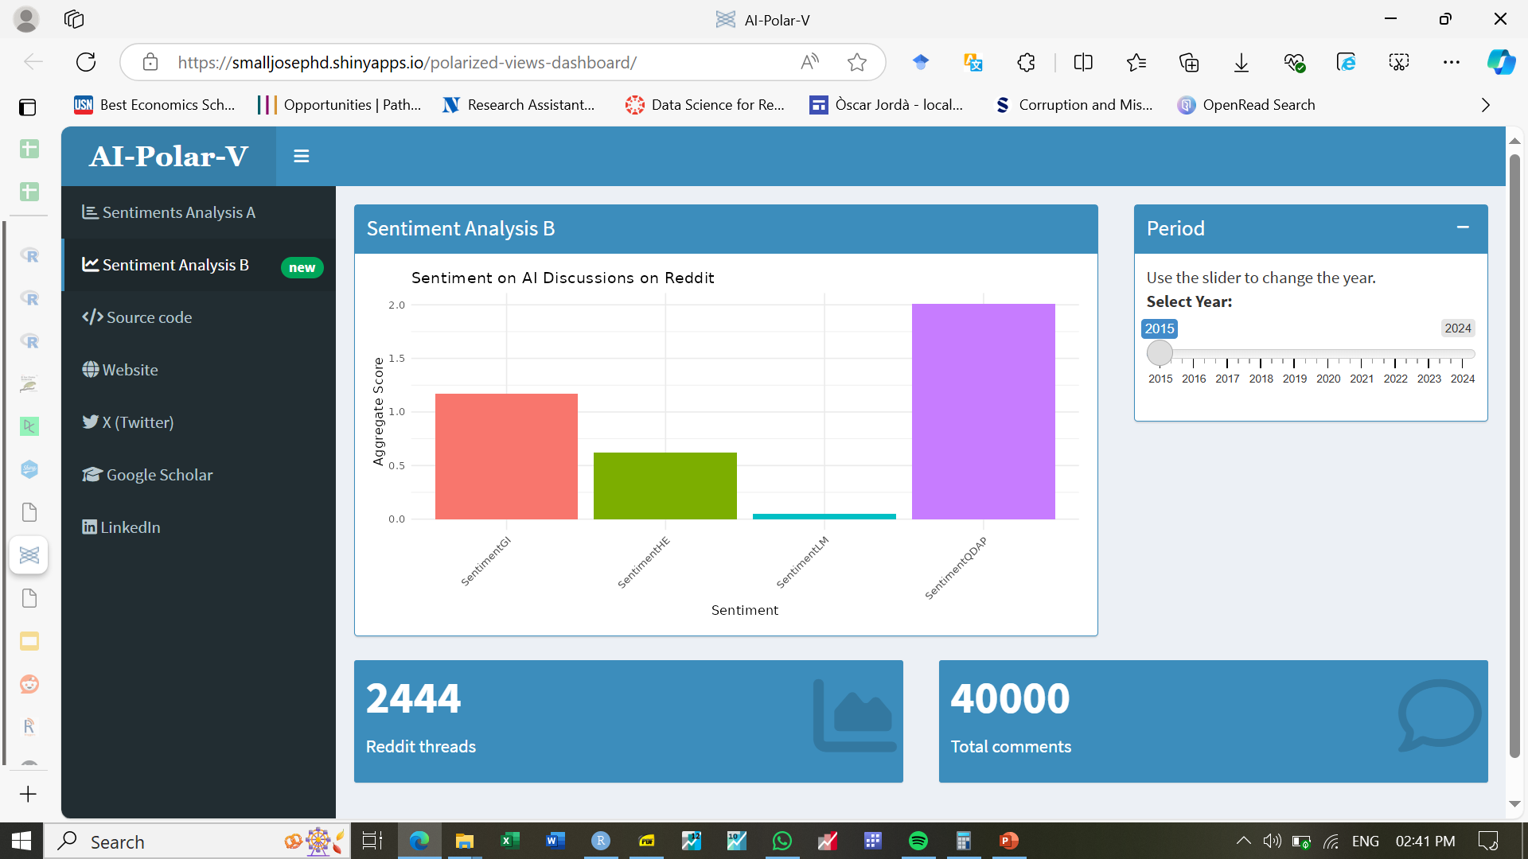
PRACTICE
Objective: Scrape posts and comments related to AI from Reddit, analyze the sentiment of the content, and visualize the results on a dashboard.

Slide 28


